Slide 1

Team 4

Slide 2
Team Members
Project Roles | Group 1 | Group 2
Project Manager | Mohd Mamoon Rasheed | Nikhil Ravuri
Product Owner | Priyanka Reddy Pallapolu | Abhilash Reddy Battu
Business Analyst | Maddula Dheeraj | Manikanta Kethireddy
Lead Developer | Surekha Maruti Salunkhe | Vinay Pusuluri
Developer | Afreen Shaik | Likith Nandendla
Lead DBA | Arjun Reddy Nareddy | Venkata Reddy Doggala
QA Analyst | Mattapally Madhvika | Sai Vamshi Krishna Gardas
Software Tester | Balu Venkat Motaparthi | Naresh Chenna

Slide 3
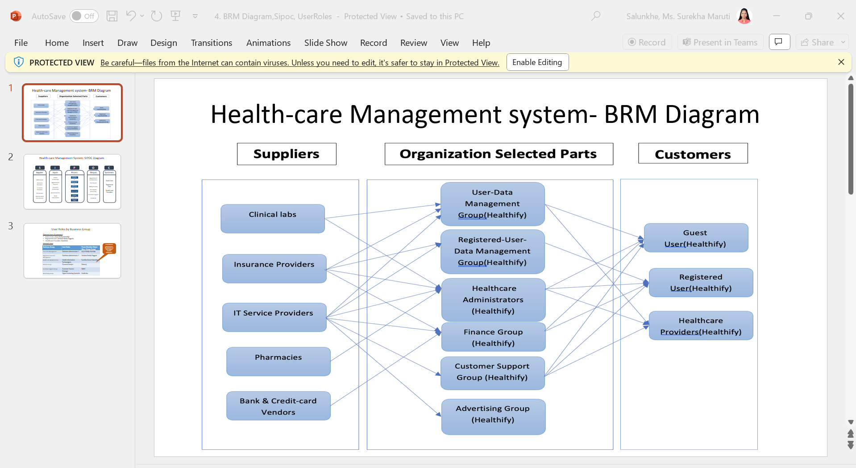
BRM (Presented by Priyanka Reddy Pallapolu & Balu Venkat Motaparthi)

Slide 4
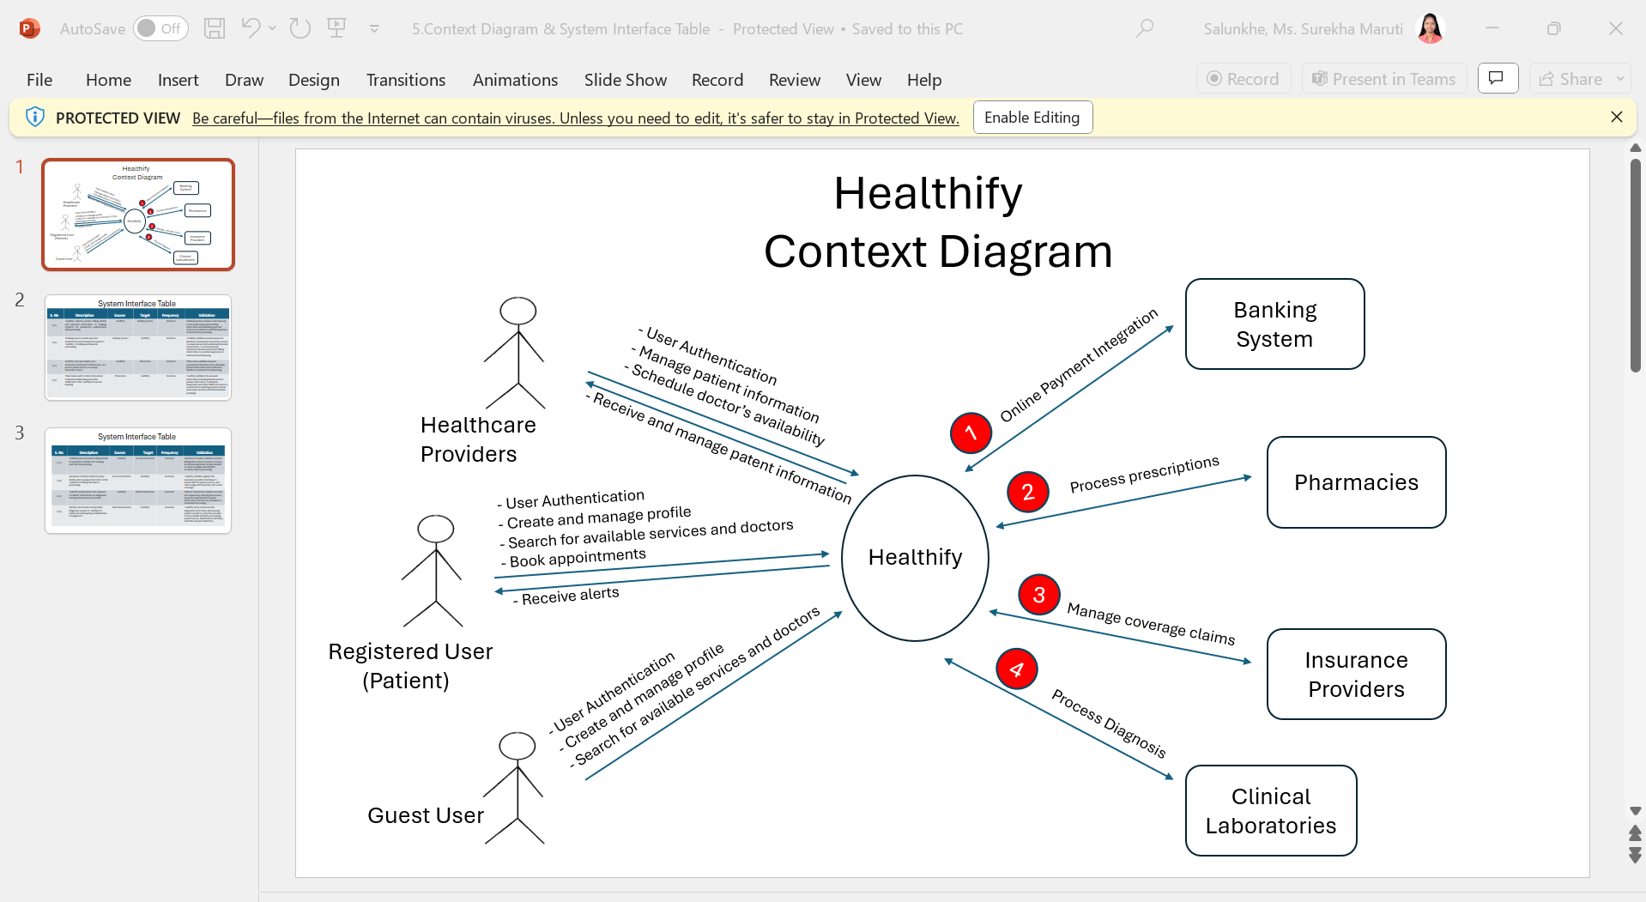
Context Diagram (Presented by Venkata Reddy Doggala & Naresh Chenna)

Slide 5
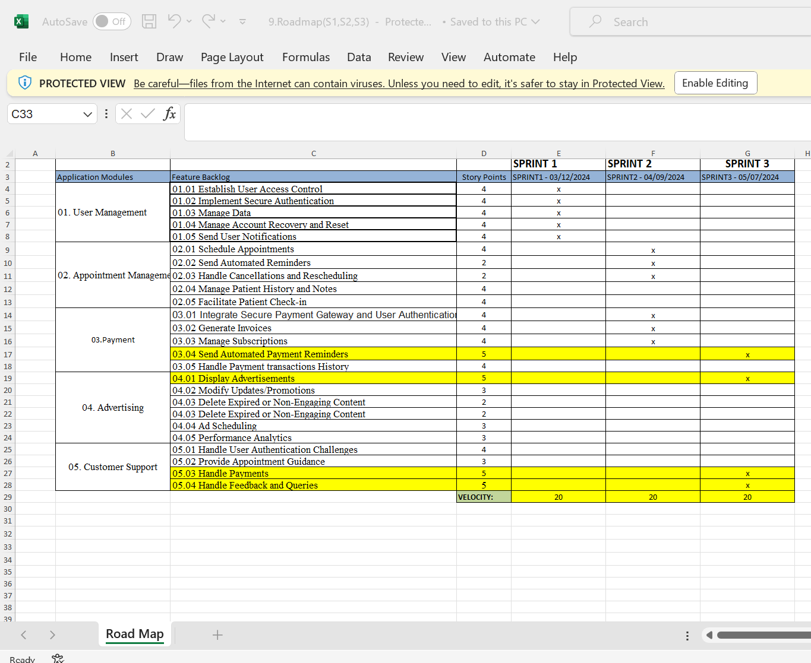
RoadMap (Presented by Mohd Mamoon Rasheed)

Slide 6
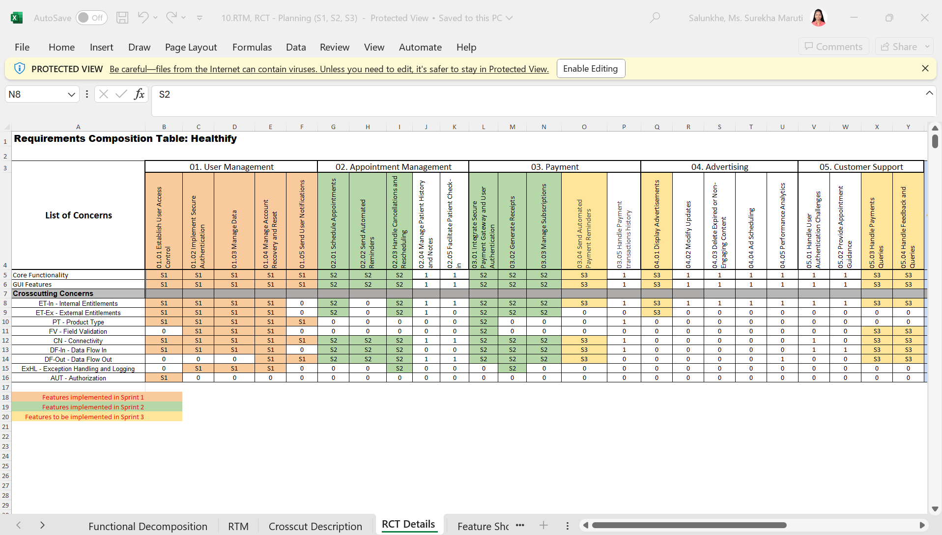
RCT (Presented by Maddula Dheeraj)

Slide 7
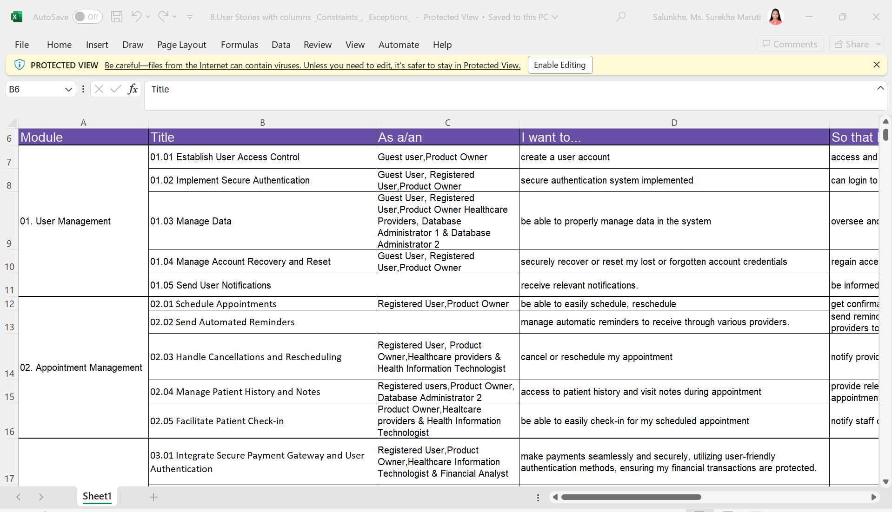
User Story (Presented by Nikhil Ravuri & Arjun Reddy Nareddy)

Slide 8
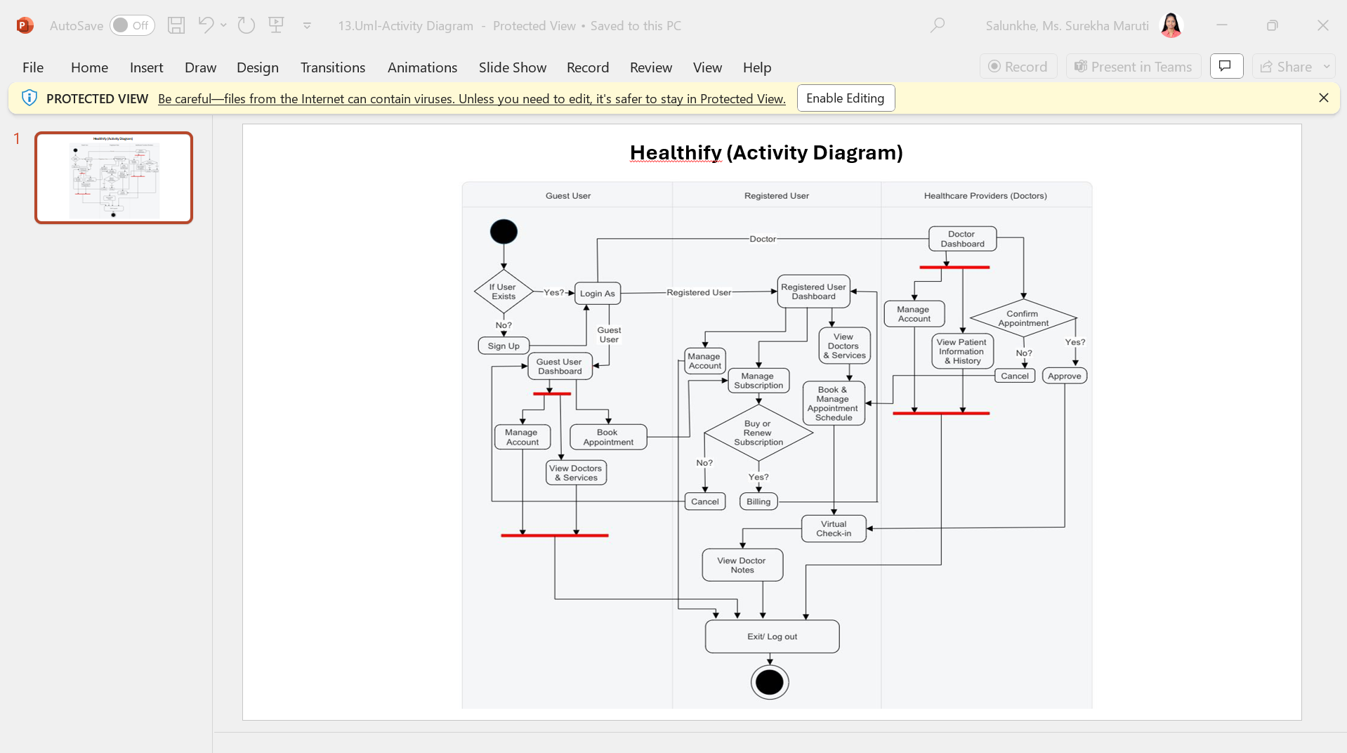
UML Activity Diagram (Presented by Manikanta Kethireddy & Abhilash Reddy Battu)

Slide 9
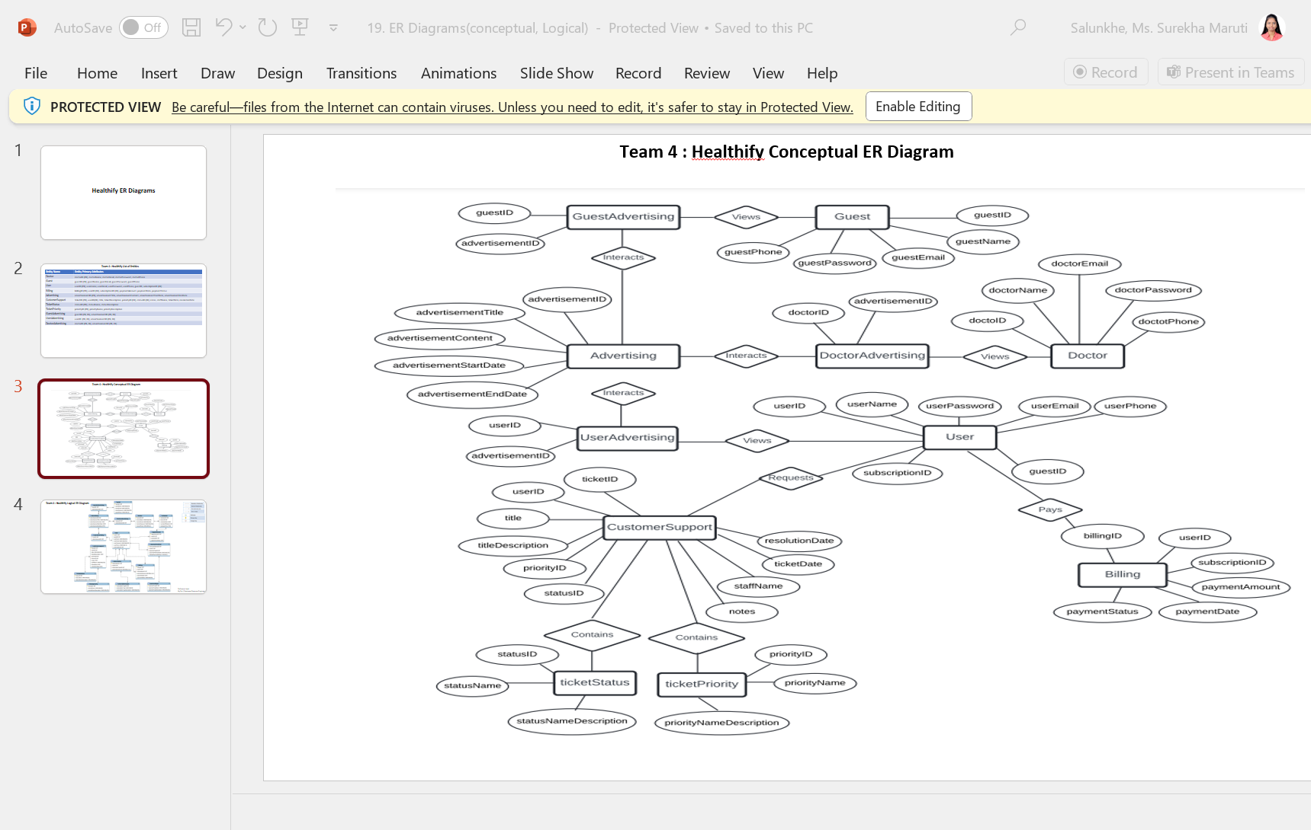
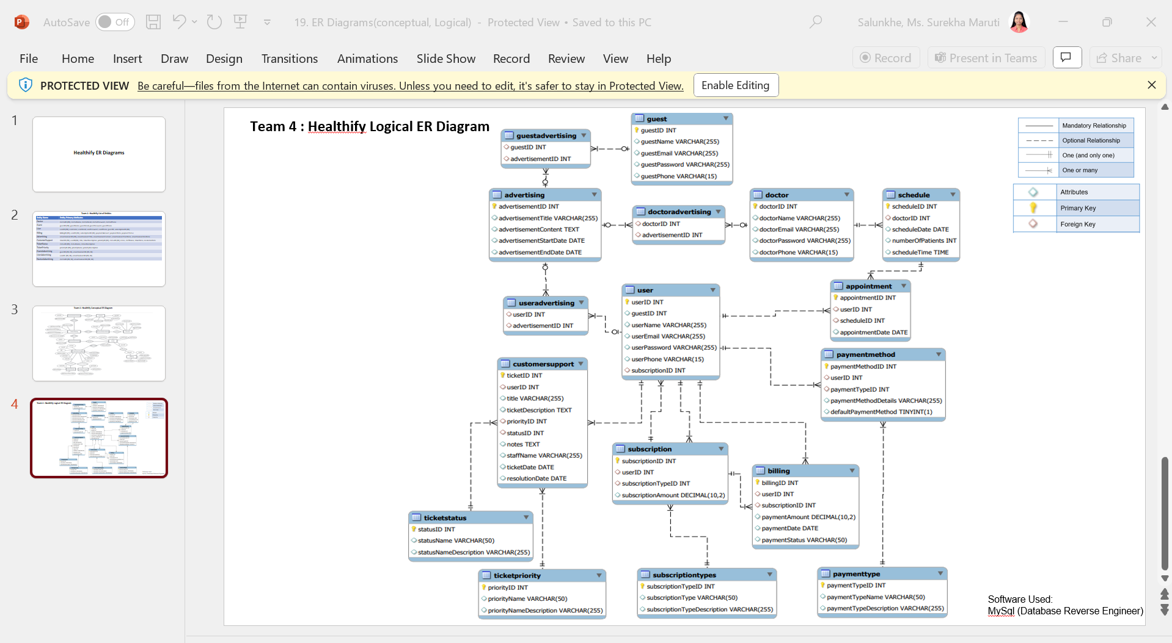
ER Diagrams (Presented by Madhvika Mattapally & Sai Vamshi Krishna Gardas)

Slide 10
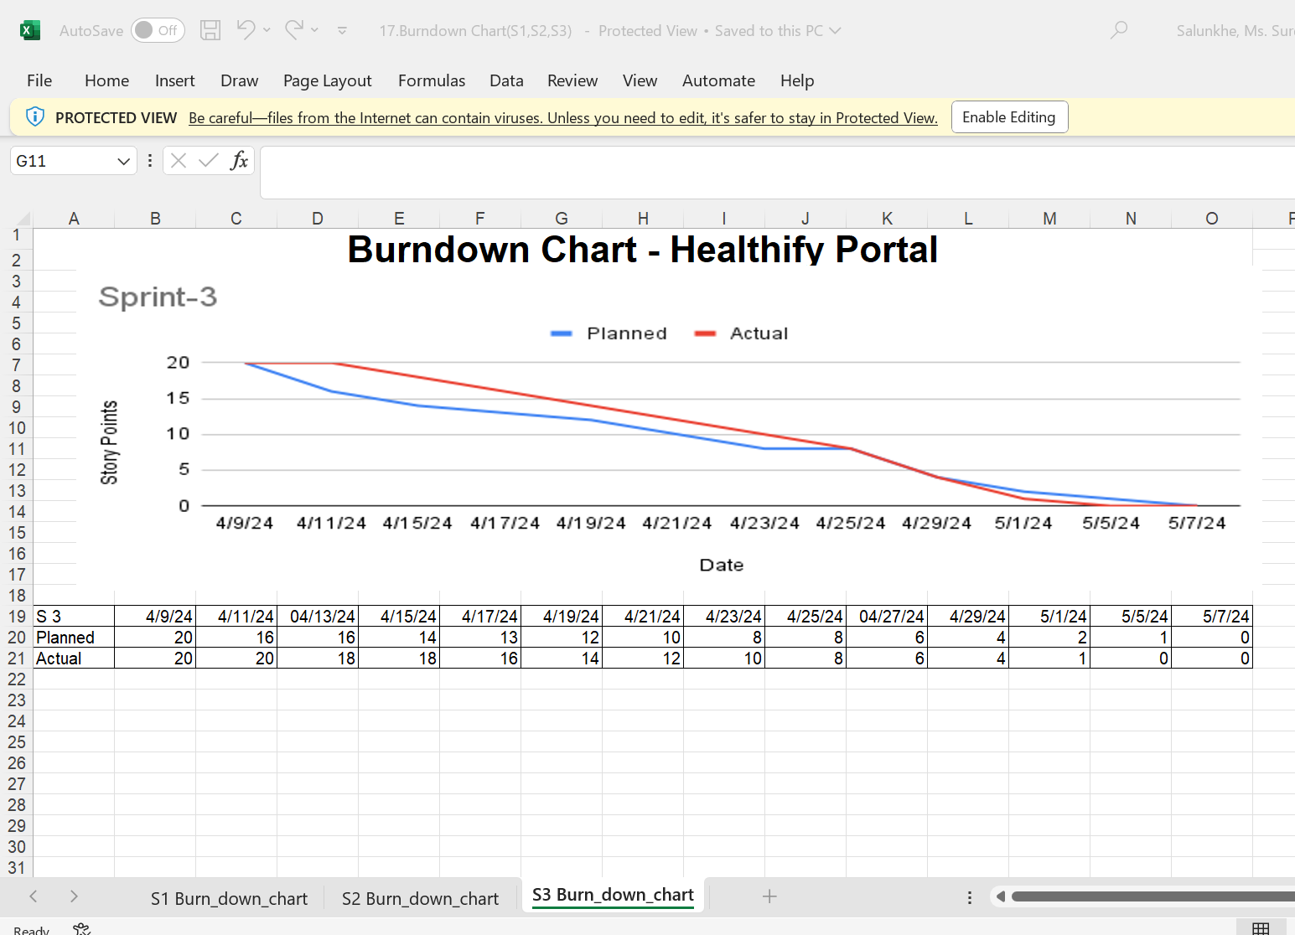
Burndown Chart (Presented by Mohd Mamoon Rasheed)

Slide 11
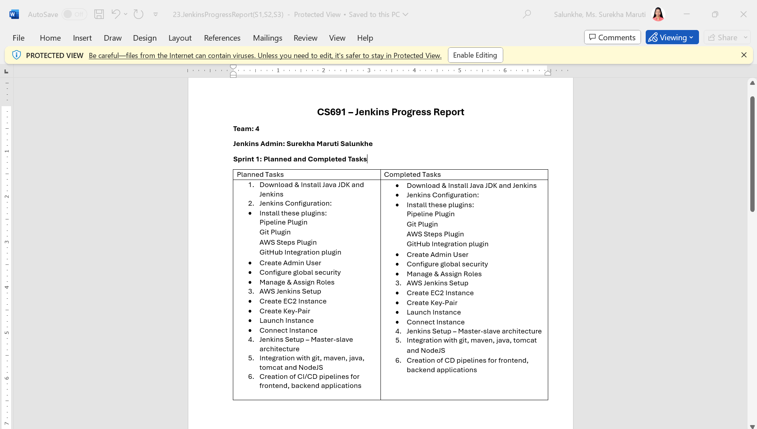
Jenkins Progress Report (Presented by Surekha Maruti Salunkhe & Afreen Shaik)

Slide 12
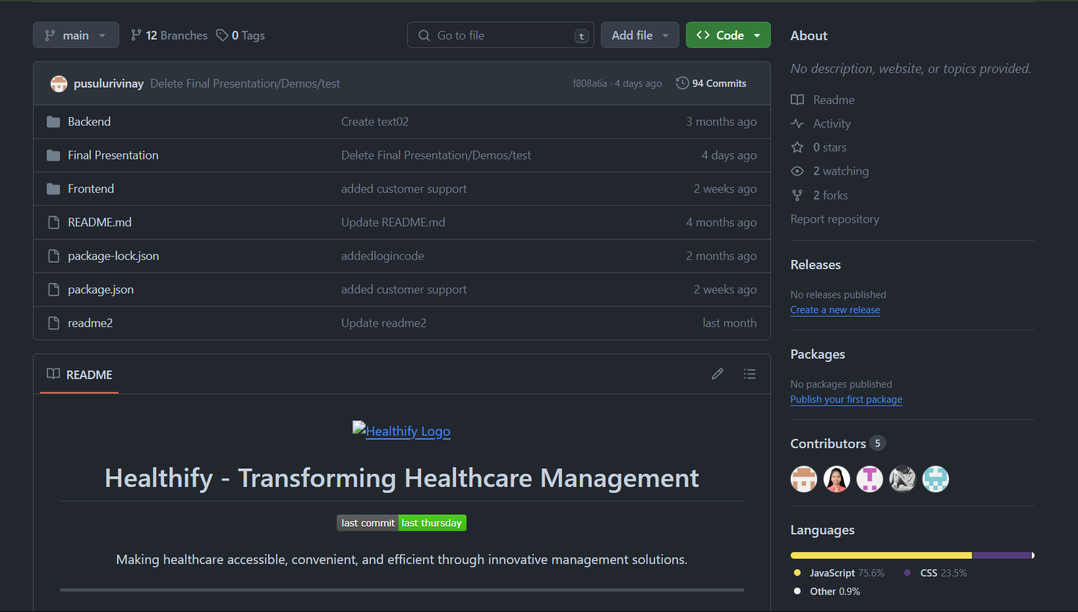
GitHub Repository (Presented by Vinay Pusuluri & Likith Nandendla)

Slide 13
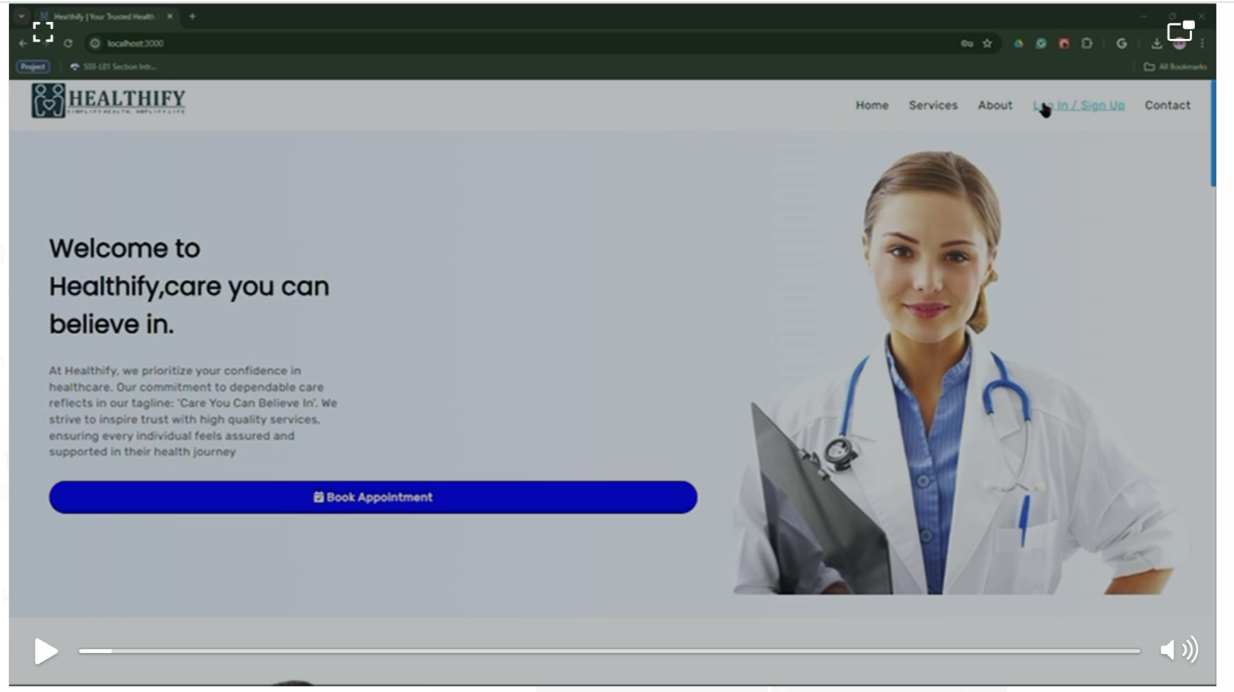
Application Demo (Presented by Vinay Pusuluri & Likith Nandendla)

Slide 14
Thank you

